Slide 1
Smart Grid Fault Detection and Performance Prediction Using Machine Learning
Data-Driven Insights for Grid Reliability & Efficiency
Presented by: Vikas Upadhyay
Date: 10/09/2025

Slide 2
Problem Statement
Smart grids must balance system reliability and energy efficiency.
Challenges:
Unexpected transformer faults → outages & costs.
Inaccurate performance metrics → poor resource allocation.
Objective:
Proactive fault detection using classification models.
Accurate efficiency prediction using regression models.

Slide 3
Dataset Overview
Records: 50,000 entries, 16 features.
Key Features:
Voltage, Current, Power, Reactive Power, Power Factor
Renewable Sources: Solar Power, Wind Power
Grid Supply, Temperature, Humidity, Electricity Price
Targets:
Transformer Fault (Binary Classification).
Power Efficiency (Derived Continuous Variable).

Slide 4
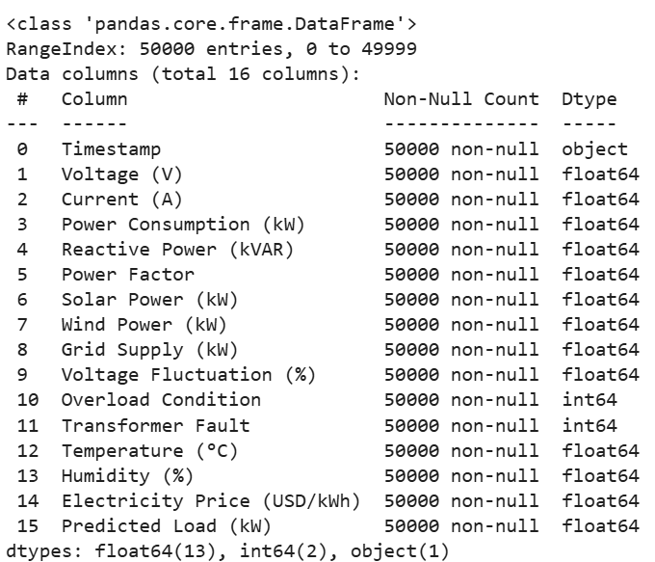
Dataset Overview

Slide 5
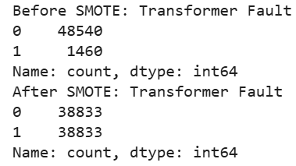
Data Cleaning & Preprocessing
Converted Timestamp → datetime.
Created Power Efficiency (%):
Efficiency= 100 x Power Consumption/Grid + Solar + Wind​
Handled class imbalance with SMOTE (Fault: 3% → 50%).
Standardized regression features.

Slide 6
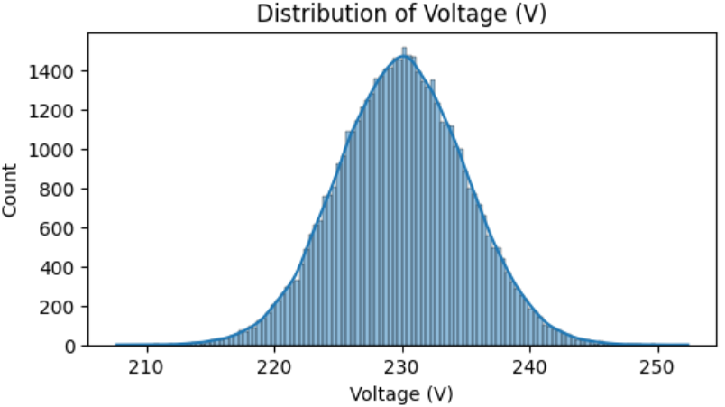
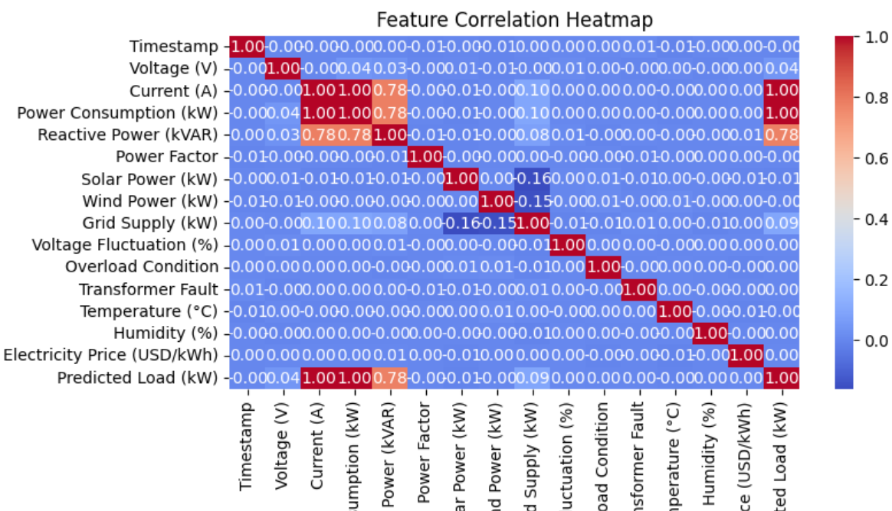
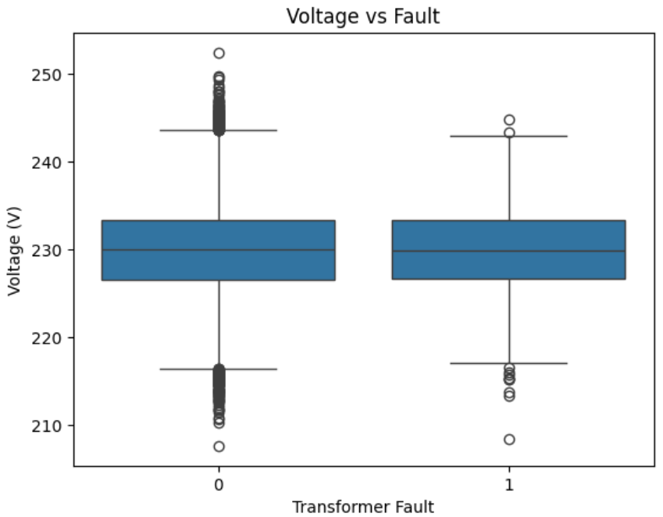
Exploratory Data Analysis (EDA)
Most features show normal or near-normal distribution.
Correlation Heatmap: Features mostly weakly correlated (< 0.3).
Observations:
Faults linked with abnormal voltage fluctuations and current spikes.
Higher renewable share → improved efficiency.

Slide 7
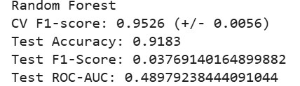
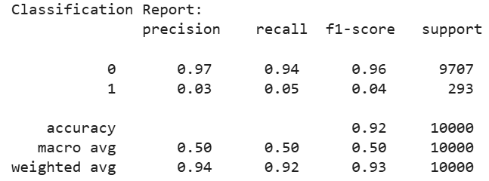
Classification Models (Fault Detection)
Models tested: Logistic Regression, Decision Tree, Random Forest, Gradient Boosting, AdaBoost, XGBoost, LightGBM, CatBoost.
Evaluation Metrics: Accuracy, F1-Score, ROC-AUC.
Key Results:
Random Forest: Accuracy = 91.8%, ROC-AUC ≈ 0.48.
Gradient Boosting & AdaBoost struggled with imbalanced data.
All models faced difficulty detecting minority class (faults).

Slide 8
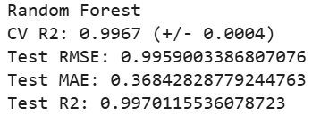
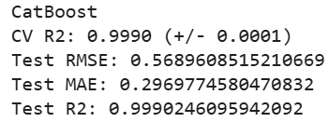
Regression Models (Efficiency Prediction)
Models tested: Linear Regression, Decision Tree, Random Forest, Gradient Boosting, AdaBoost, XGBoost, LightGBM, CatBoost.
Evaluation Metrics: RMSE, MAE, R².
Key Results:
Linear Regression (baseline): R² = 0.76.
Random Forest: RMSE = 0.99, R² = 0.997.
CatBoost: RMSE = 0.57, R² = 0.999 → Best model.

Slide 9
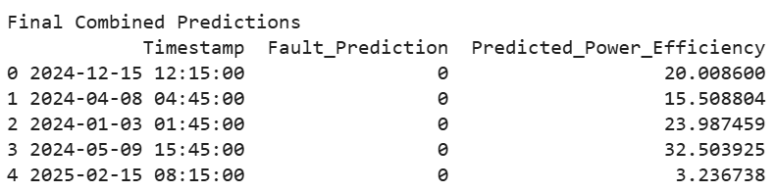
Final Predictions
Combined predictions include:
Fault Prediction (0/1).
Predicted Power Efficiency (%).

Slide 10
Observations & Insights
Fault Detection
Severe class imbalance = major challenge.
Faults correlated with abnormal operational patterns.
Efficiency Prediction
Regression models performed exceptionally well (R² > 0.99).
Renewable power strongly contributes to efficiency.

Slide 11
Statistical Hypotheses
H₀: Faults occur randomly.
Rejected → Linked to voltage/current anomalies.
H₀: Renewable share has no effect on efficiency.
Rejected → Higher renewable input improves efficiency.
H₀: Environment (temperature, humidity) does not affect efficiency.
Partially accepted → Weak correlation.

Slide 12
Recommendations
Use anomaly detection or time-series models for rare fault prediction.
Collect more fault samples for balanced training.
Enhance real-time monitoring of voltage fluctuations and power factor.
Increase renewable adoption for efficiency gains.
Use predictive modeling to optimize pricing & load balancing.

Slide 13
Conclusion
Regression models (CatBoost, RF) achieved near-perfect efficiency prediction.
Classification models struggled with rare fault detection.
Project demonstrates the power of ML in smart grid analytics, but highlights the need for better fault modeling approaches.

Slide 14

The End

